Slide 1
Chapter 11
Relational Database Design Algorithms and Further Dependencies
Copyright © 2007 Ramez Elmasri and Shamkant B. Navathe

Slide 2
Chapter Outline
0. Designing a Set of Relations
1. Properties of Relational Decompositions
2. Algorithms for Relational Database Schema
Slide 11- <number>

Slide 3
DESIGNING A SET OF RELATIONS (1)
The Approach of Relational Synthesis (Bottom-up Design):
  Assumes that all possible functional dependencies are known.
  First constructs a minimal set of FDs
  Then applies algorithms that construct a target set of 3NF or BCNF relations.
  Additional criteria may be needed to ensure the set of relations in a relational database are satisfactory (see Algorithms 11.2 and 11.4).
Slide 11- <number>

Slide 4
DESIGNING A SET OF RELATIONS (2)
Goals:
  Lossless join property (a must)
    Algorithm 11.1 tests for general losslessness.
  Dependency preservation property
    Algorithm 11.3 decomposes a relation into BCNF components by sacrificing the dependency preservation.
Slide 11- <number>

Slide 5
1. Properties of Relational Decompositions (1)
Relation Decomposition and Insufficiency of Normal Forms:
  Universal Relation Schema:
    A relation schema R = {A1, A2, …, An} that includes all the attributes of the database.
  Universal relation assumption:
    Every attribute name is unique.
Slide 11- <number>

Slide 6
Properties of Relational Decompositions (2)
Relation Decomposition and Insufficiency of Normal Forms (cont.):
  Decomposition:
    The process of decomposing the universal relation schema R into a set of relation schemas D = {R1,R2, …, Rm} that will become the relational database schema by using the functional dependencies.
  Attribute preservation condition:
    Each attribute in R will appear in at least one relation schema Ri in the decomposition so that no attributes are “lost”.
Slide 11- <number>

Slide 7
Properties of Relational Decompositions (2)
Another goal of decomposition is to have each individual relation Ri in the decomposition D be in BCNF or 3NF.
Additional properties of decomposition are needed to prevent from generating spurious tuples
Slide 11- <number>

Slide 8
Properties of Relational Decompositions (3)
Dependency Preservation Property of a Decomposition:
  Definition: Given a set of dependencies F on R, the projection of F on R_{i}, denoted by p_{Ri}(F) where R_{i} is a subset of R, is the set of dependencies X  Y in F⁺ such that the attributes in X υ Y are all contained in R_{i}.
  Hence, the projection of F on each relation schema R_{i} in the decomposition D is the set of functional dependencies in F⁺, the closure of F, such that all their left- and right-hand-side attributes are in R_{i}.
Slide 11- <number>

Slide 9
Properties of Relational Decompositions (4)
Dependency Preservation Property of a Decomposition (cont.):
  Dependency Preservation Property:
    A decomposition D = {R1, R2, ..., Rm} of R is dependency-preserving with respect to F if the union of the projections of F on each Ri in D is equivalent to F; that is
    ((π_{R1}(F)) υ . . . υ (π_{Rm}(F)))⁺ = F⁺
Claim 1:
  It is always possible to find a dependency-preserving decomposition D with respect to F such that each relation Ri in D is in 3nf.
Slide 11- <number>

Slide 10
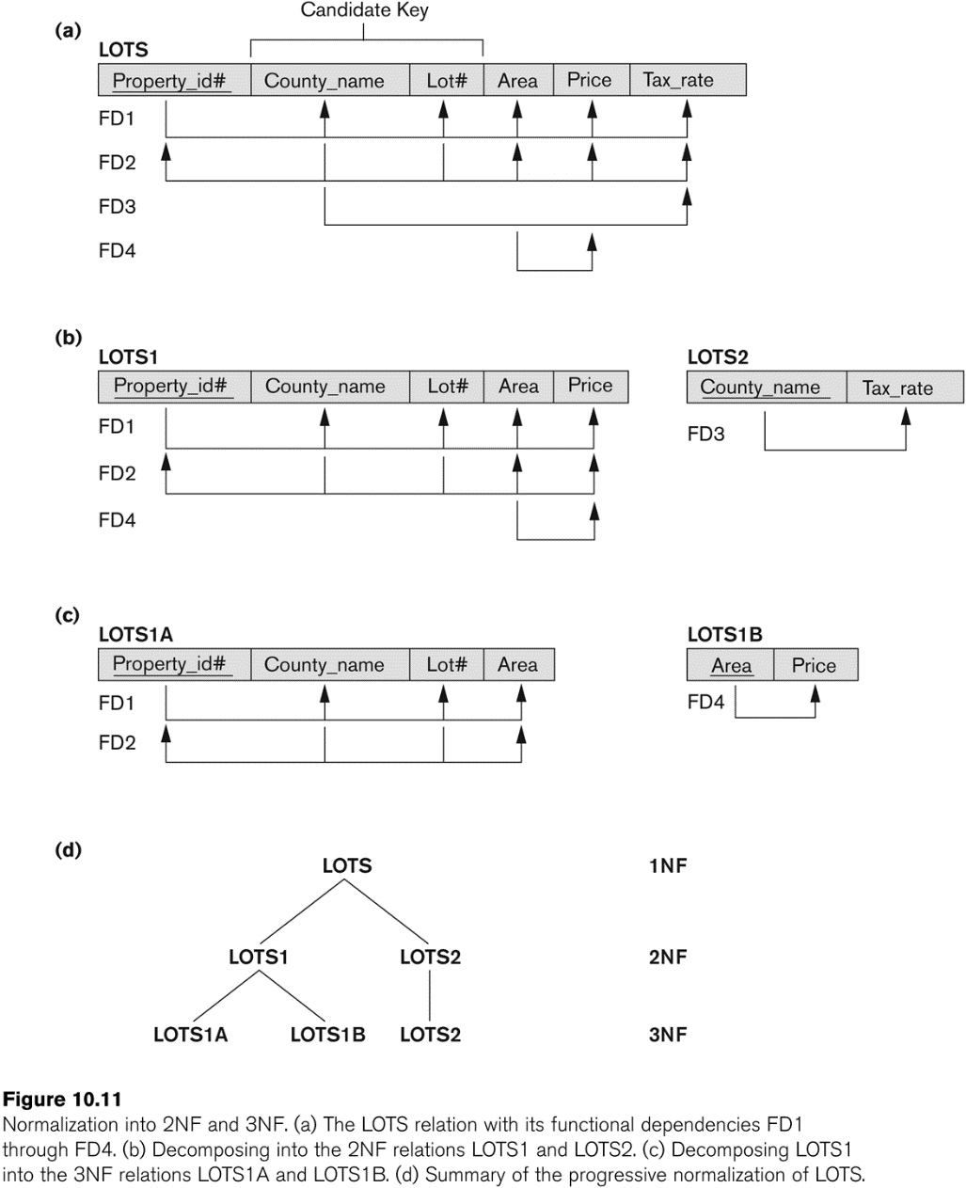
Properties of Relational Decompositions (4)
Dependency Preservation Property:
  A decomposition D = {R1, R2, ..., Rm} of R is dependency-preserving with respect to F if the union of the projections of F on each Ri in D is equivalent to F; that is
  ((π_{R1}(F)) υ . . . υ (π_{Rm}(F)))⁺ = F⁺
Lots={Property_id, Country_name, Lot#, Area, Price, Tax_rate}
Lots1A={Property_id, Country_name, Lot#, Area}
Lots1B={Area, Price}
Lots2={Country_name, Tax_rate}
Lots1A U Lots1B U Lots2 = Lots
Slide 11- <number>

Slide 11
Properties of Relational Decompositions (5)
Lossless (Non-additive) Join Property of a Decomposition:
  Definition: Lossless join property: a decomposition D = {R1, R2, ..., Rm} of R has the lossless (nonadditive) join property with respect to the set of dependencies F on R if, for every relation state r of R that satisfies F, the following holds, where * is the natural join of all the relations in D:
* (π _{R1}(r), ..., π_{Rm}(r)) = r
  Note: The word loss in lossless refers to loss of information, not to loss of tuples. In fact, for “loss of information” a better term is “addition of spurious information”
Slide 11- <number>

Slide 12
Properties of Relational Decompositions (6)
Lossless (Non-additive) Join Property of a Decomposition (cont.):
Algorithm 11.1: Testing for Lossless Join Property
  Input: A universal relation R, a decomposition D = {R1, R2, ..., Rm} of R, and a set F of functional dependencies.
1. Create an initial matrix S with one row i for each relation Ri in D, and one column j for each attribute Aj in R.
2. Set S(i,j):=bij for all matrix entries. (* each bij is a distinct symbol associated with indices (i,j) *).
3. For each row i representing relation schema Ri
{for each column j representing attribute Aj
{if (relation Ri includes attribute Aj) then set S(i,j):= aj;};};
  (* each aj is a distinct symbol associated with index (j) *)
  CONTINUED on NEXT SLIDE
Slide 11- <number>

Slide 13
Properties of Relational Decompositions (7)
Lossless (Non-additive) Join Property of a Decomposition (cont.):
Algorithm 11.1: Testing for Lossless Join Property
4. Repeat the following loop until a complete loop execution results in no changes to S
{for each functional dependency X Y in F
{for all rows in S which have the same symbols in the columns corresponding to attributes in X
{make the symbols in each column that correspond to an attribute in Y be the same in all these rows as follows:
If any of the rows has an “a” symbol for the column, set the other rows to that same “a” symbol in the column.
If no “a” symbol exists for the attribute in any of the rows, choose one of the “b” symbols that appear in one of the rows for the attribute and set the other rows to that same “b” symbol in the column ;};
};
};
5. If a row is made up entirely of “a” symbols, then the decomposition has the lossless join property; otherwise it does not.
Slide 11- <number>

Slide 14
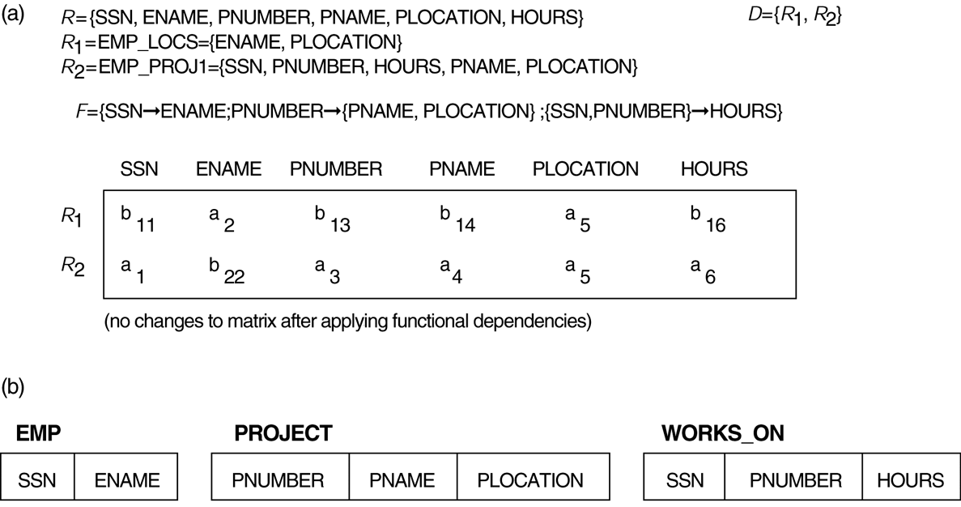
Properties of Relational Decompositions (8)
Lossless (nonadditive) join test for n-ary decompositions.
(a) Case 1: Decomposition of EMP_PROJ into EMP_PROJ1 and EMP_LOCS fails test.
(b) A decomposition of EMP_PROJ that has the lossless join property.
Slide 11- <number>

Slide 15
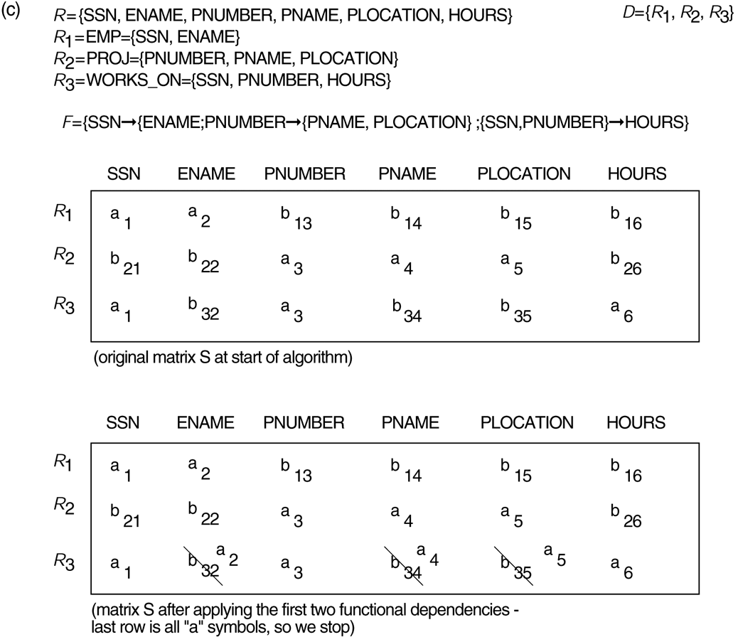
Properties of Relational Decompositions (8)
Lossless (nonadditive) join test for n-ary decompositions.
(c) Case 2: Decomposition of EMP_PROJ into EMP, PROJECT, and WORKS_ON satisfies test.
Slide 11- <number>

Slide 16
Properties of Relational Decompositions (9)
Testing Binary Decompositions for Lossless Join Property
  Binary Decomposition: Decomposition of a relation R into two relations.
  PROPERTY LJ1 (lossless join test for binary decompositions): A decomposition D = {R1, R2} of R has the lossless join property with respect to a set of functional dependencies F on R if and only if either
    The f.d. ((R1 ∩ R2)  (R1- R2)) is in F⁺, or
    The f.d. ((R1 ∩ R2)  (R2 - R1)) is in F⁺.
Slide 11- <number>

Slide 17
Properties of Relational Decompositions (8)
R1 ∩ R2 = {PLOCATION}
R1- R2 = {ENAME}
R2- R1 = {SSN, PNUMBER, HOURS, PNAME}
{PLOCATION}  {ENAME} ?
{PLOCATION}  {SSN, PNUMBER, HOURS, PNAME} ?
PLOCATION does not exist at the LHS of any of the FDs.
Slide 11- <number>

Slide 18
Properties of Relational Decompositions (10)
Successive Lossless Join Decomposition:
  Claim 2 (Preservation of non-additivity in successive decompositions):
    If a decomposition D = {R1, R2, ..., Rm} of R has the lossless (non-additive) join property with respect to a set of functional dependencies F on R,
    and if a decomposition Di = {Q1, Q2, ..., Qk} of Ri has the lossless (non-additive) join property with respect to the projection of F on Ri,
      then the decomposition D2 = {R1, R2, ..., Ri-1, Q1, Q2, ..., Qk, Ri+1, ..., Rm} of R has the non-additive join property with respect to F.
Slide 11- <number>

Slide 19
2. Algorithms for Relational Database Schema Design (1)
Algorithm 11.2: Relational Synthesis into 3NF with Dependency Preservation (Relational Synthesis Algorithm)
  Input: A universal relation R and a set of functional dependencies F on the attributes of R.
1. Find a minimal cover G for F (use Algorithm 10.2);
2. For each left-hand-side X of a functional dependency that appears in G,
create a relation schema in D with attributes {X υ {A1} υ {A2} ... υ {Ak}},
where X  A1, X  A2, ..., X  Ak are the only dependencies in G with X as left-hand-side (X is the key of this relation) ;
3. Place any remaining attributes (that have not been placed in any relation) in a single relation schema to ensure the attribute preservation property.
  Claim 3: Every relation schema created by Algorithm 11.2 is in 3NF.
Slide 11- <number>

Slide 20
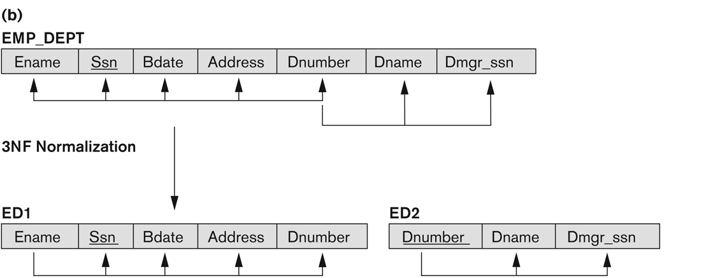
Example:
Recall:
SSN->Bdate, Ename, Address, Dnumber
Dnumber->Dname, Dmgr_ssn
create a relation schema in D with attributes {X υ {A1} υ {A2} ... υ {Ak}},
where X  A1, X  A2, ..., X  Ak are the only dependencies in G with X as left-hand-side (X is the key of this relation) ;
Slide 11- <number>

Slide 21
Algorithms for Relational Database Schema Design (2)
Algorithm 11.3: Relational Decomposition into BCNF with Lossless (non-additive) join property
  Input: A universal relation R and a set of functional dependencies F on the attributes of R.
1. Set D := {R};
2. While there is a relation schema Q in D that is not in BCNF
do {
choose a relation schema Q in D that is not in BCNF;
find a functional dependency X  Y in Q that violates BCNF;
replace Q in D by two relation schemas (Q - Y) and (X υ Y);
};
Assumption: No null values are allowed for the join attributes.
Slide 11- <number>

Slide 22
Example:
Recall our previous example:
  fd1: { student, course} -> instructor
  fd2: instructor -> course
  Decomposition into (Q - Y) and (X υ Y)
  Result: {instructor, student} and {instructor, course }
Q
X
Y
Slide 11- <number>

Slide 23
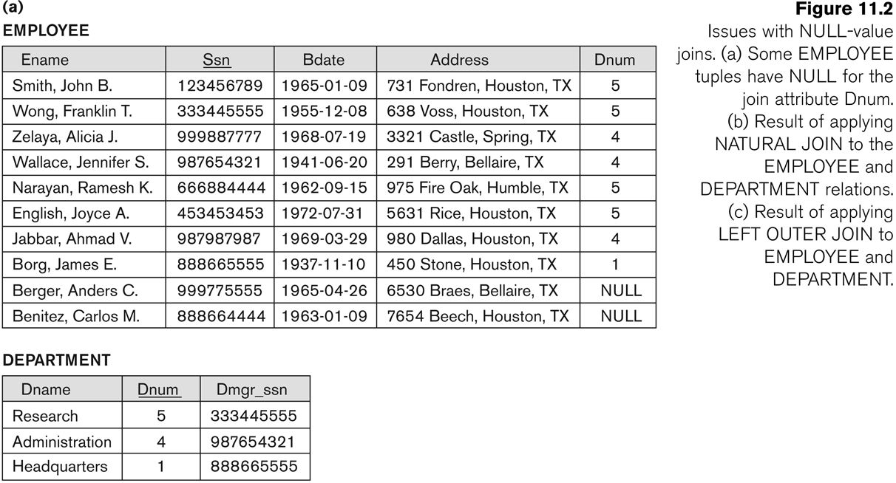
Algorithms for Relational Database Schema Design (5)
Slide 11- <number>

Slide 24
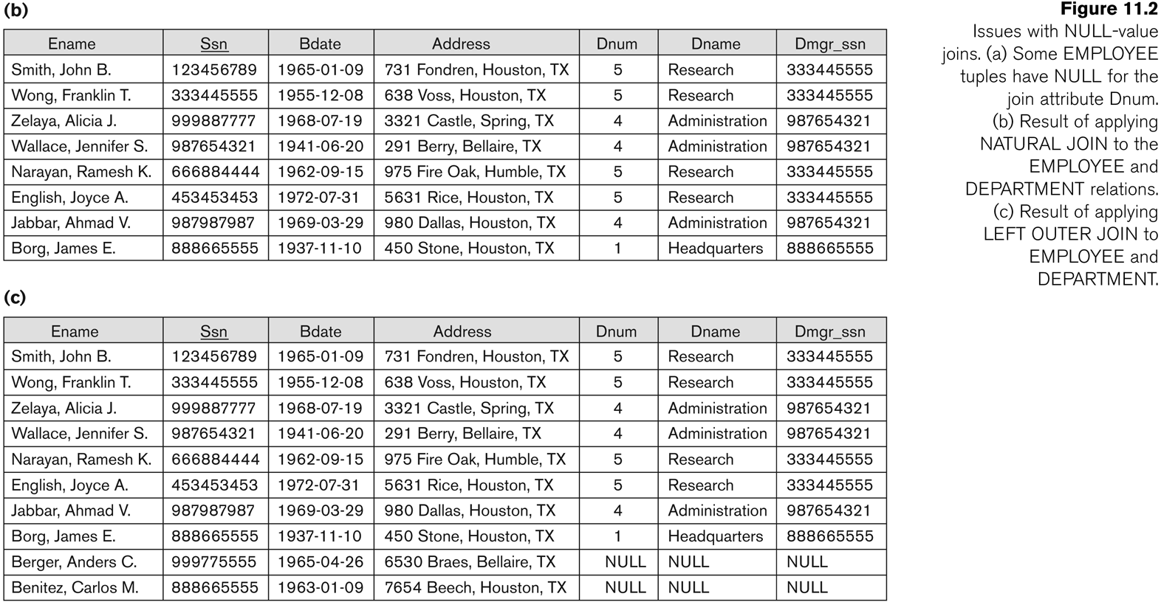
Algorithms for Relational Database Schema Design (5)
Slide 11- <number>

Slide 25
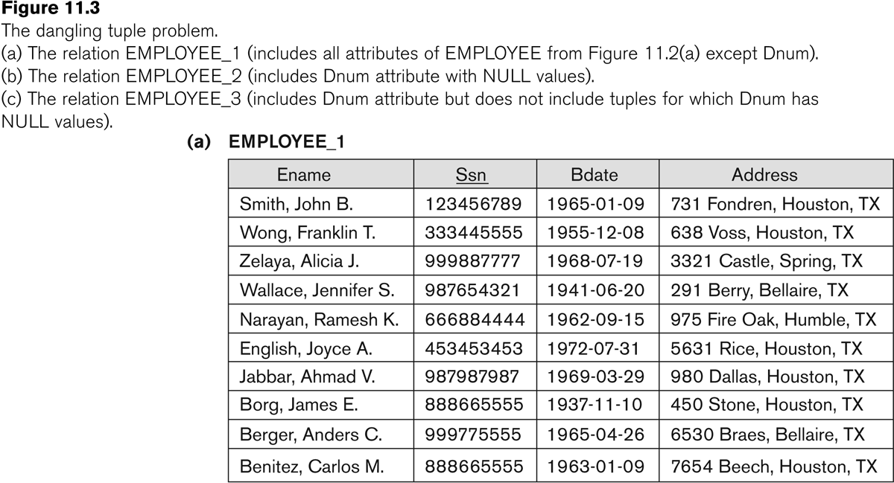
Algorithms for Relational Database Schema Design (6)
Slide 11- <number>
Notes:
Called dangling tuples because they are represented in only one of the two relations that represent employees and hence are lost if we apply an (INNER) JOIN operation.
A related problem is that of dangling tuples, which may occur if we carry a decomposition too far. Suppose that we decompose the EMPLOYEE relation further into EMPLOYEE_1 and EMPLOYEE_2. If we apply natural join operation to EMPLOYEE_1 and EMPLOYEE_2, we get the original EMPLOYEE relation. However, we may use the alternative representation where we do not include a tuple in EMPLOYEE_3 if the employee has not been assigned a department (instead of including a tuple with NULL for Dnum as in EMPLOYEE_2). If we use EMPLOYEE_3 instead of EMPLOYEE_2 and apply a natural join on EMPLOYEE_1 and EMPLOYEE_3, the tuples for Berger and Benitez will not appear in the result, there are called dangling tuples in EMPLOYEE_1 because they are represented in only one of the two relations that represent employees, and hence are lost if we apply an INNER join operation.

Slide 26
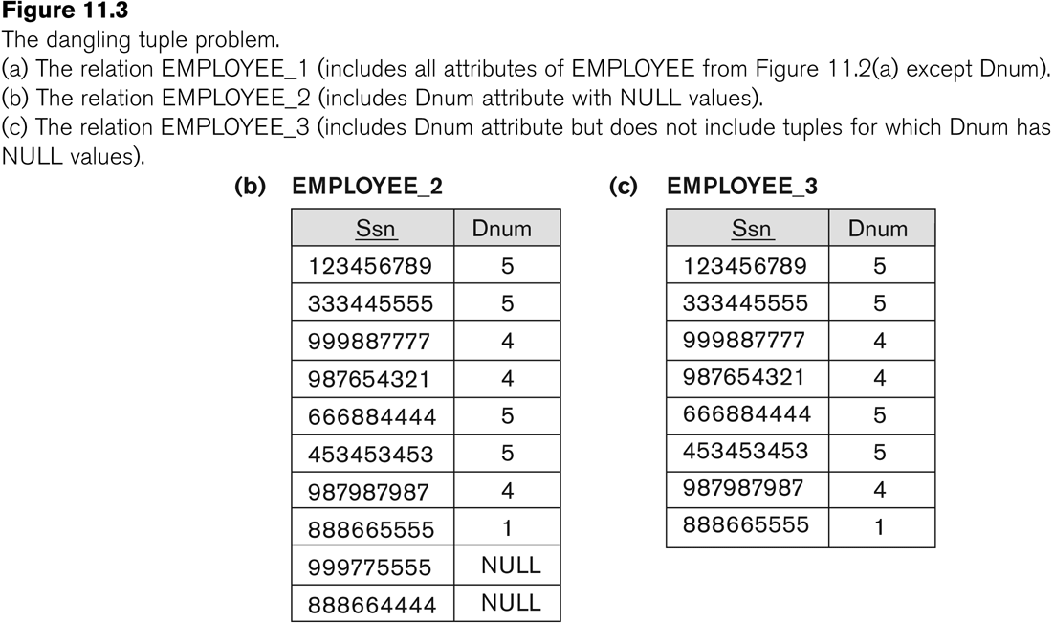
Algorithms for Relational Database Schema Design (6)
Slide 11- <number>

Slide 27
Algorithms for Relational Database Schema Design (7)
Discussion of Normalization Algorithms:
Problems:
  The database designer must first specify all the relevant functional dependencies among the database attributes.
  These algorithms are not deterministic in general.
  It is not always possible to find a decomposition into relation schemas that preserves dependencies and allows each relation schema in the decomposition to be in BCNF (instead of 3NF as in Algorithm 11.4).
Slide 11- <number>

Slide 28
Recap
Designing a Set of Relations
Properties of Relational Decompositions
Algorithms for Relational Database Schema
Slide 11- <number>

Slide 29
Recap about normalization
1NF: no nested, multivalued tuples
2NF:if every non prime attribute A in R is fully functionally dependent on the primary key.
3NF: A non prime attribute A in R is transitively dependent on the primary key.
BNCF: a 3NF relation with no dependency of prime attributes on non prime attributes.
Slide 11- <number>

Slide 30

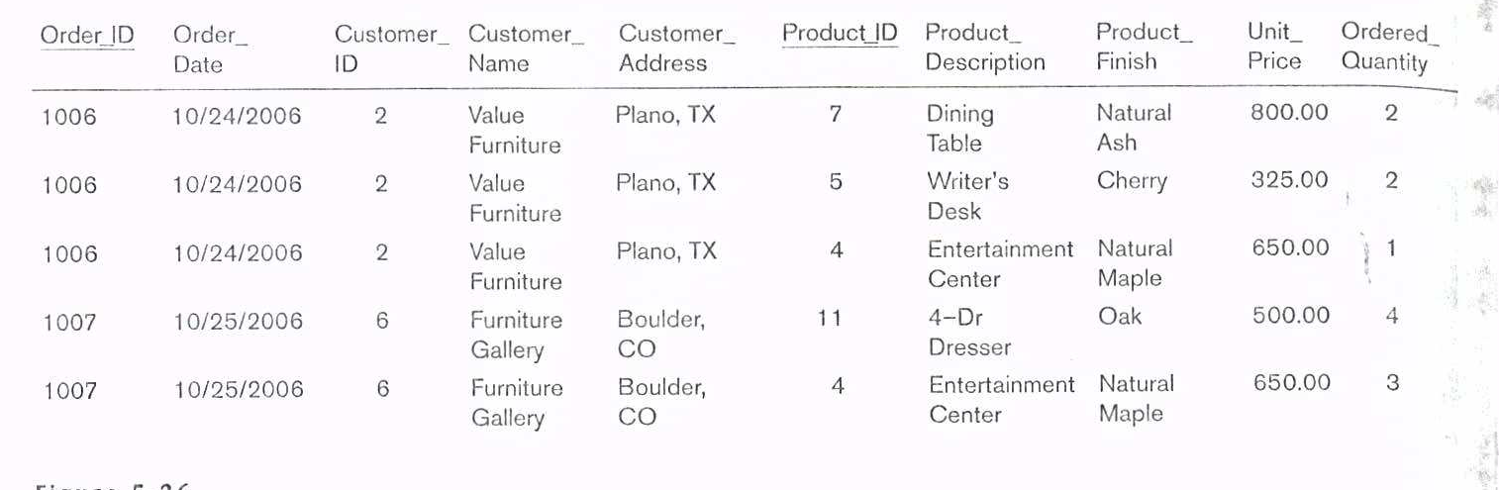
Example
In which normal form is it? Decompose the relations as to satisfy BCNF.
Slide 11- <number>

Slide 31
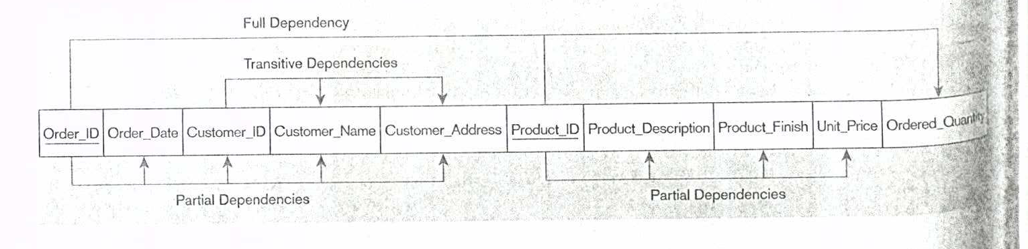
Example
Slide 11- <number>

Slide 32
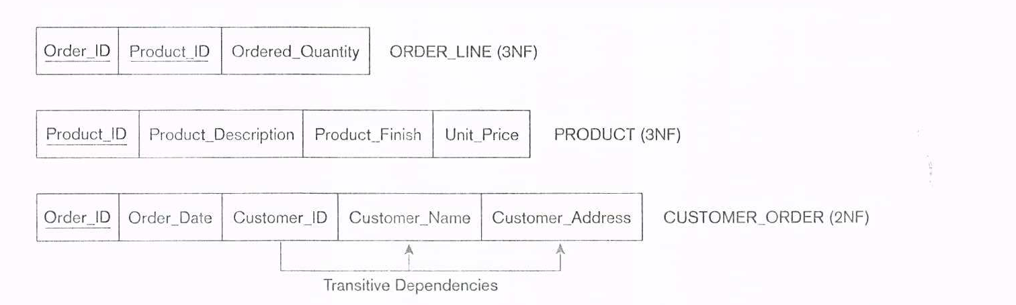
Example
Convert into 2NF
1.Create a new relation for each primary key attribute (or combination of attributes) that is a determinant in a partial dependency. That attribute is the primary key in the new relation.
2. Move the nonkey attributes that are dependent on this primary key attribute (or attributes) from the old relation to the new relation.
Slide 11- <number>

Slide 33
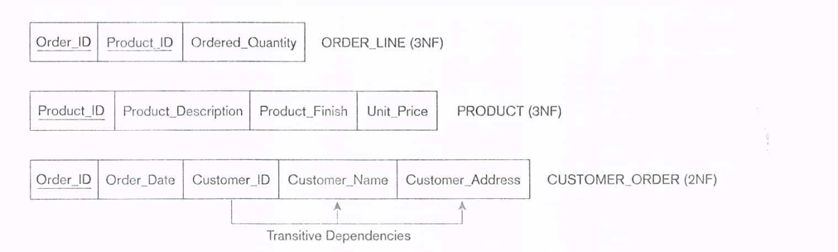

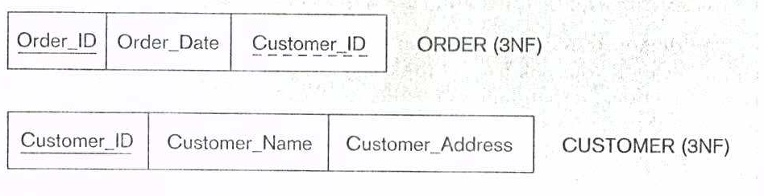
Example
Convert into 3NF
A relation is in third normal form (3NF) if it is in second normal form and no transitive dependencies exist. A transitive dependency in a relation is a functional dependency between two (or more) nonkey attributes.
Customer_ID -> Customer_Name
Customer_ID -> Customer_Address
Slide 11- <number>

Slide 34
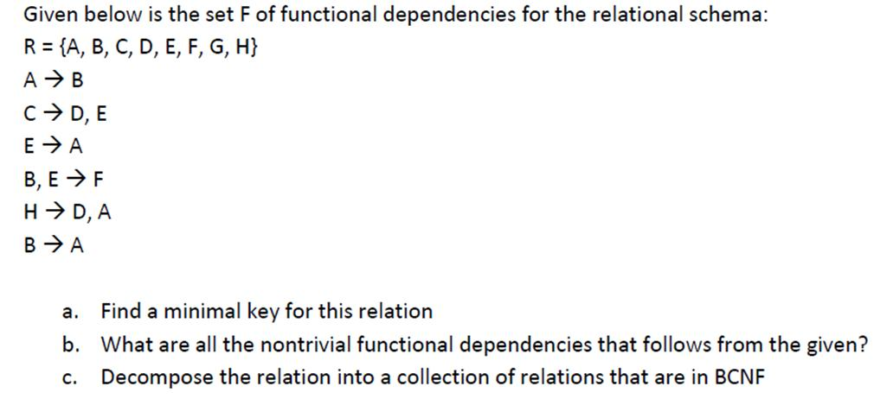
Example:
Reference: www.cs.tau.ac.il/~boim/courses/databases2009
Slide 11- <number>

Slide 35
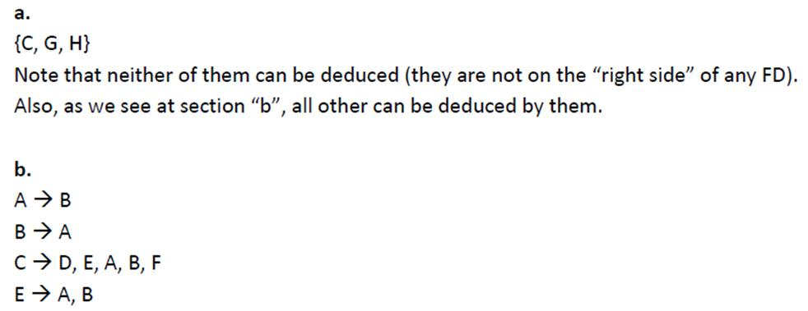
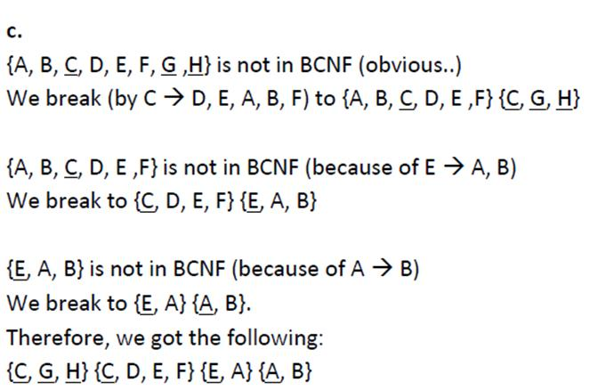

Example:
Because of E-> F the final result will be: {CGH} {E,F} {C,D,E} {E,A} {A,B}
Reference: www.cs.tau.ac.il/~boim/courses/databases2009
Slide 11- <number>
Notes:
E-Fye gidiyor duzelt.

Slide 36
Example
Consider a relation R with attributes R-> {A,B,C,D,E,M} and the FD set F={M→AB, DEM→C, B→C, BD→E, M→D}
  Decide whether the following decompositions are (i) dependency preserving , (ii) lossless join (ii) in BCNF Form.
  {BDE}, {BC}, {MAC}, {MB}, {MDE}
  {MABC}, {BC}, {MDE}, {BDE}
  {MBC}, {DEMC},{MA}, {BDE}
Slide 11- <number>

Slide 37
Example
F={M→AB, DEM→C, B→C, BD→E, M→D}
If we find the minimal set of R:
From BD→E, M→D (Pseudotransitivity)then we have BM→E
From M→B and BM→E (Pseudotransitivity), we have M→E
From DEM→C, M→E, M→D (Pseudotransitivity), we have M→C.
My set: {M→A, M→B, M→C, M→D, M→E, B→C, BD→E}
My minimal set: {M→A, M→B, M→D, B→C, BD→E}
Slide 11- <number>

Slide 38
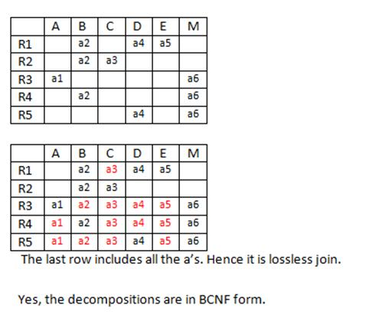
Example
{BDE}, {BC}, {MAC}, {MB}, {MDE}
According to the set:
ΠR1(F)=BD→E
ΠR2(F)= B→C
ΠR3(F)=M→A, M→C
ΠR4(F)=M→B
ΠR5(F)= M→D, M→E
a3
a5
a3
a5
Slide 11- <number>

Slide 39
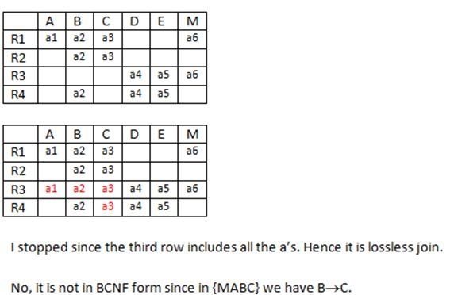
Example
{MABC}, {BC}, {MDE}, {BDE}
According to set:
ΠR1(F)= B→C, M→ABC
ΠR2(F)= B→C
ΠR3(F)= M→D, M→E
ΠR4(F)= BD→E
Slide 11- <number>

Slide 40
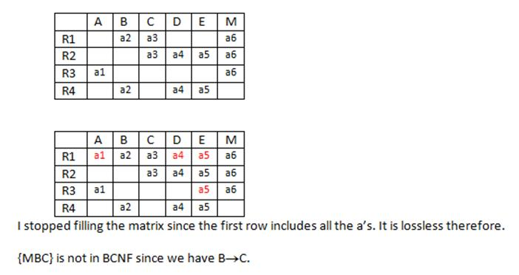
Example
{MBC}, {DEMC},{MA}, {BDE}
According to set:
ΠR1(F)= M→C, M→B, B→C
ΠR2(F)= M→C, M→D, M→E
ΠR3(F)= M→A
ΠR4(F)= BD→E
It is dependency preserving according to the minimal FD set.
Slide 11- <number>

